Slide 1
Linux Operations

Slide 2

Linux
An operating system, like macOS or Windows
Open Source OS by Linus Torvalds, first released in 1991
There are different “distros”, each with their own perks
E.g. Debian, RedHat, Alpine
Most of the servers and mobile devices use Linux
Android
Tesla?

Slide 3

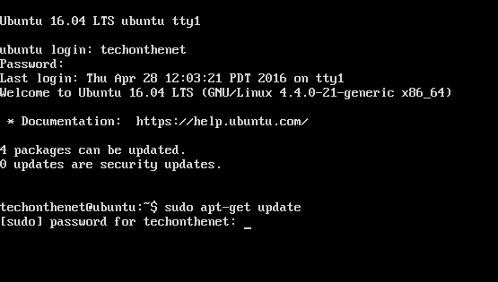
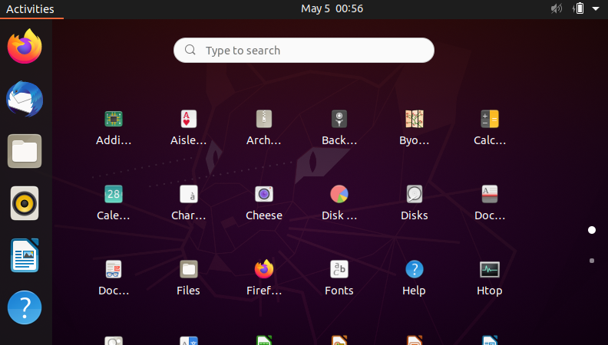
User interface
The operating system Ubuntu has two versions.
Ubuntu Server
User interaction with: bash
Ubuntu Desktop
User interaction with: gnome
(Note: bash is also installed)

Slide 4
Can an operating system pair with different GUI?
YES.
A GUI is just a software running on a given operating system.
However, common OS like Windows and MacOS does not give you option to replace their default GUI.
Reference: How to install a GUI on ubuntu
https://phoenixnap.com/kb/how-to-install-a-gui-on-ubuntu

Slide 5
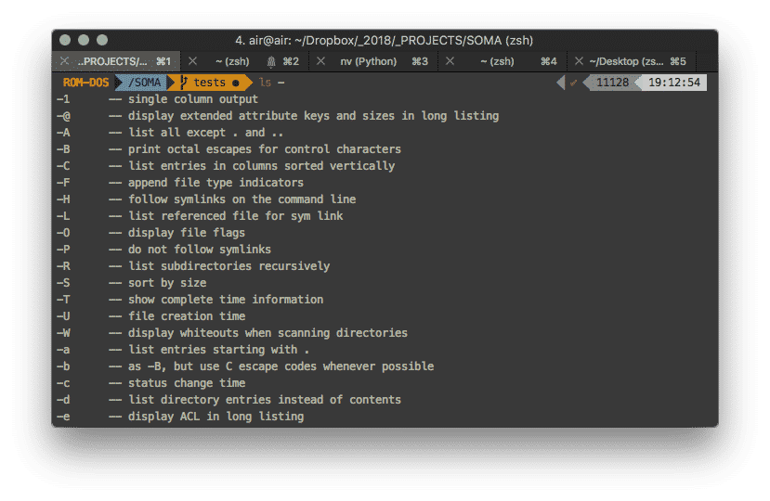
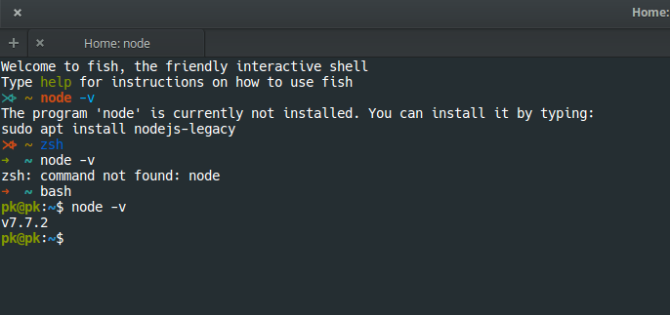
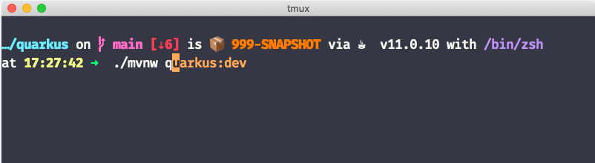
Shell
The application that allow users to send command to the system
It is the command-line interface we always see
Common shells are bash and zsh
Debian default: bash
Mac default: zsh
Windows default: cmd/powershell🤡

Slide 6
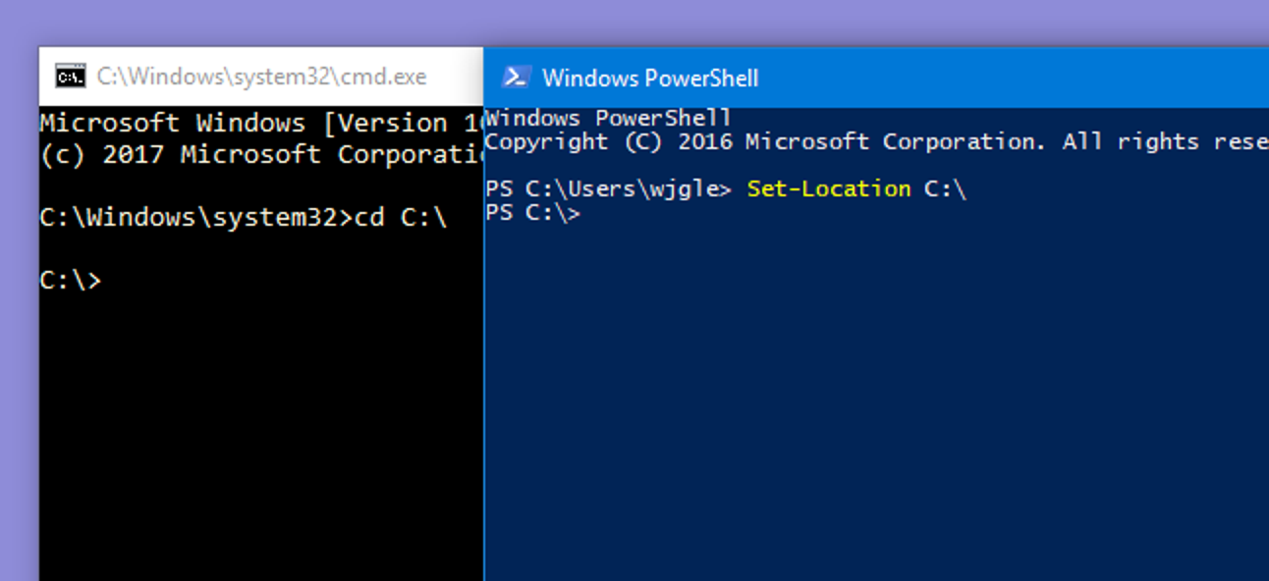
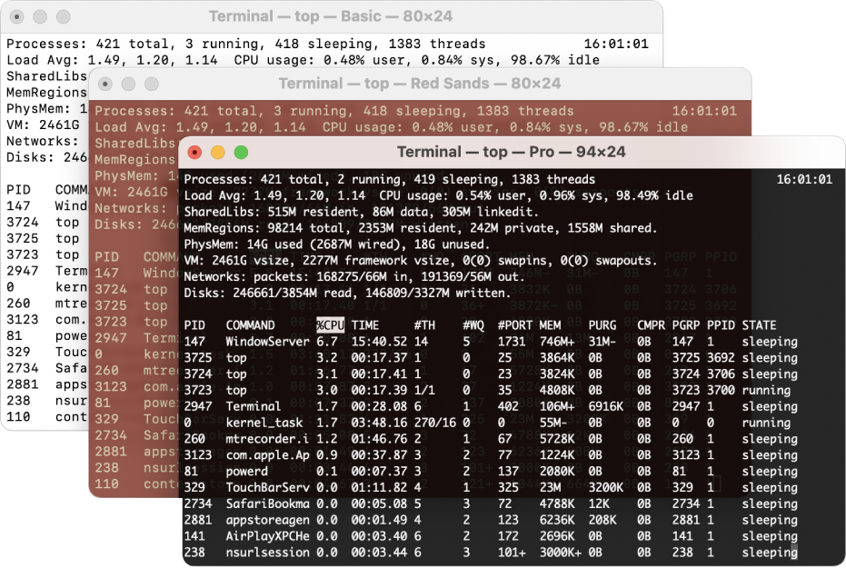
Can we run a shell on GUI?
YES.
We achieve this with a terminal software.
On Windows, terminal software and the shell is bundled. That is, cmd.exe runs cmd and powershell.exe runs powershell.
On Mac, the “Terminal” app starts your default shell (zsh or bash depends on configuration). “iTerm2” is an alternative to the “Terminal” app.

Slide 7
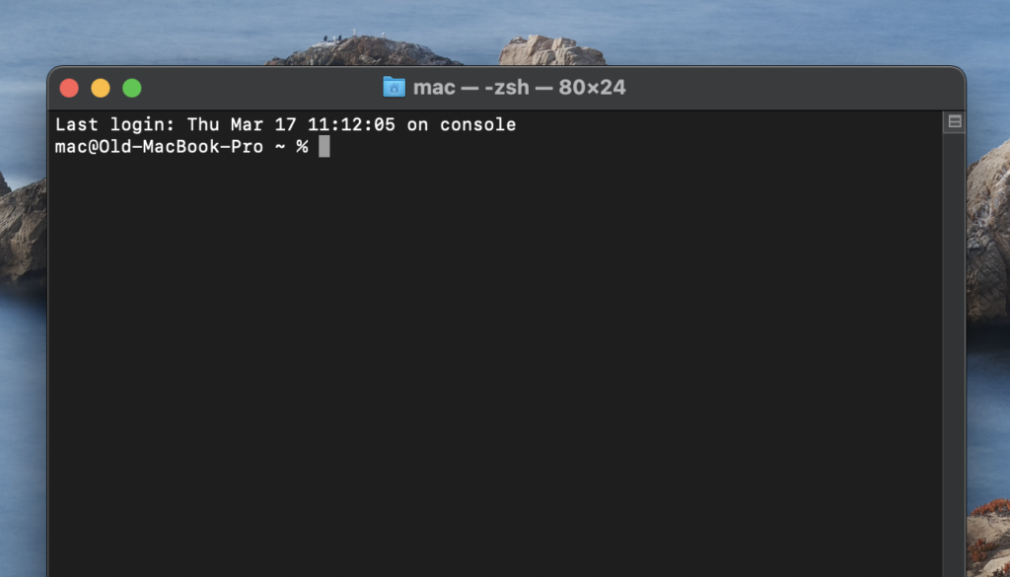
Remote control with CLI
Execute
Connect
Pass commands
zsh
ssh
sshd
bash
Internet
Ubuntu Server
User interaction with: bash
No monitor in most of the time
MacOS
User interaction with default GUI

Slide 8
Use cases
Use CLI tools that no GUI has been developed yet
Remote control a server/a group of server that has no GUI
Development and/or Debugging applications
Run scripts
A quick way to perform sophisticated things, for example
search for all files that contain multiple keywords
Replace some text from all files within a folder
Look cool

Slide 9
Where to find a Linux CLI for practicing
Terminal on Mac / Linux
WSL (Windows Subsystem Linux) on Windows
Cloud Shell on Google Cloud Console / AWS Console

Slide 10
Try: Connect to a remote machine through SSH

Slide 11
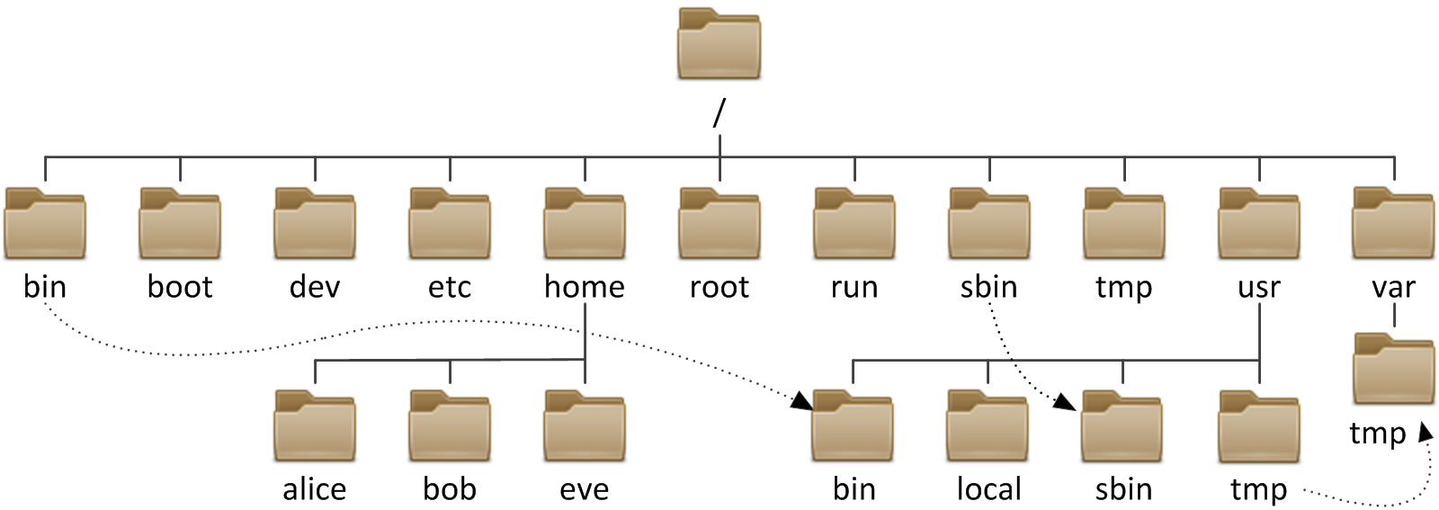
Linux directory structure
~
~
~
Image from: https://www.serverkaka.com/2018/01/key-locations-in-linux-file-system_21.html

Slide 12
~ folder (directory)
~ is an alias to your home folder.
If your username is bob, your ~ is /home/bob.
Also, cd without a parameter equals cd ~

Slide 13
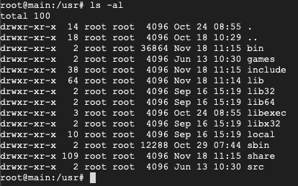
Concepts
One dot = Current Dir
File/Folder owner
Two dots = Parent Dir
File/Folder group
File/Folder permissions
File/Folder name
User name
Machine name
Current Directory
Last modify datetime

Slide 14
List of common commands
cd ls rm mv cat mkdir | chown chmod ln -s (symbolic link; shortcut) echo sudo cp | echo "123" > text.txt #Write to file echo "123" >> text.txt # Append to file
ssh vim/nano apt/apt-get/yum

Slide 15

Commands
The program (like a function)
Arguments
New line comes out only after the last command finished execution
Quote(") means to treat functional characters as normal string
Spaces are separators (So, do not include extra spaces!)

Slide 16
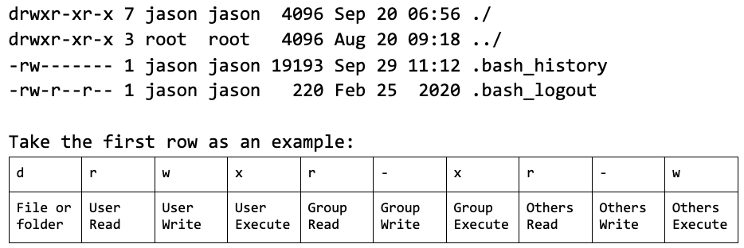
Permissions

Slide 17
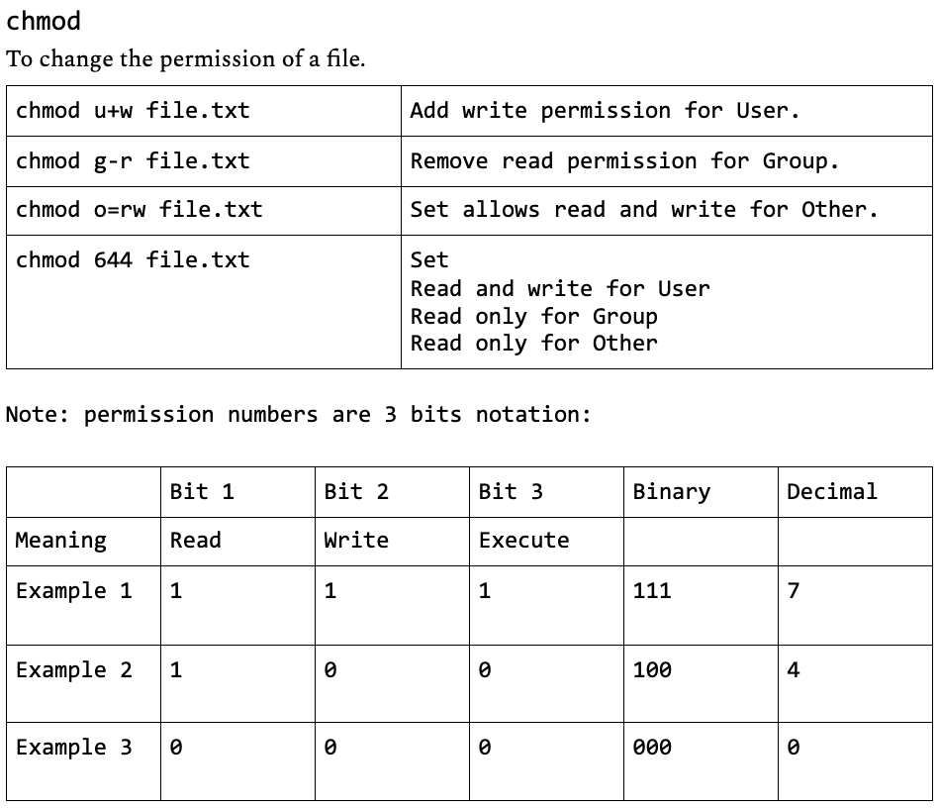
Change permission

Slide 18
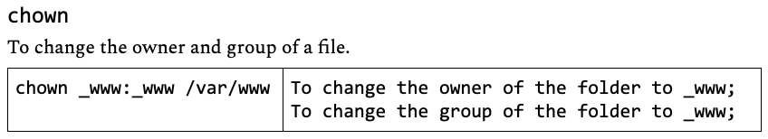
Change owner

Slide 19
SSH - Secure shell
Usage: Connection to a remote shell.
Common authentication methods:
Password (Seldom use nowadays)
Private key / Public key pairs
Generate key with ssh-keygen
Connect with ssh
Important files under ~/.ssh: # As a client known_hosts id_rsa Id_rsa.pub config # As a server Authorized_keys

Slide 20
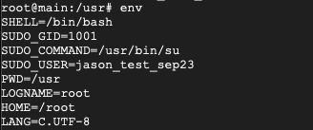
Environment variable
Variables that is available to all applications
Allow a small piece of information to be shared between applications
Example:
A java based application reads the JAVA_HOME variable to locate the java binaries

Slide 21
Demo: SSH into a cloud VM

Slide 22
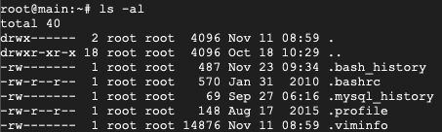

.bashrc, .profile, $PATH
.bashrc or .profile or .zshrc
These files are executed when you first login to a shell
$PATH
The program search path. It tells the shell where to find a program to execute.
Very common to set PATH in .bashrc, so that we do not have to worry about search path again once it is set

Slide 23
Extra stuff
., .., and current working directory in Python
autocomplete
--help
.爸爸的文件夾
sudo
Package managers
Pipe “|”
$
Vim editor: https://vim-adventures.com/

Slide 24
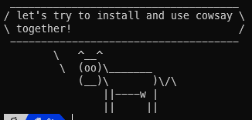
Cowsay
Let’s install and play with cowsay for fun!
Shell
Package Manager -> know how to install package
Permission
How to run the cowsay command

